Slide 1
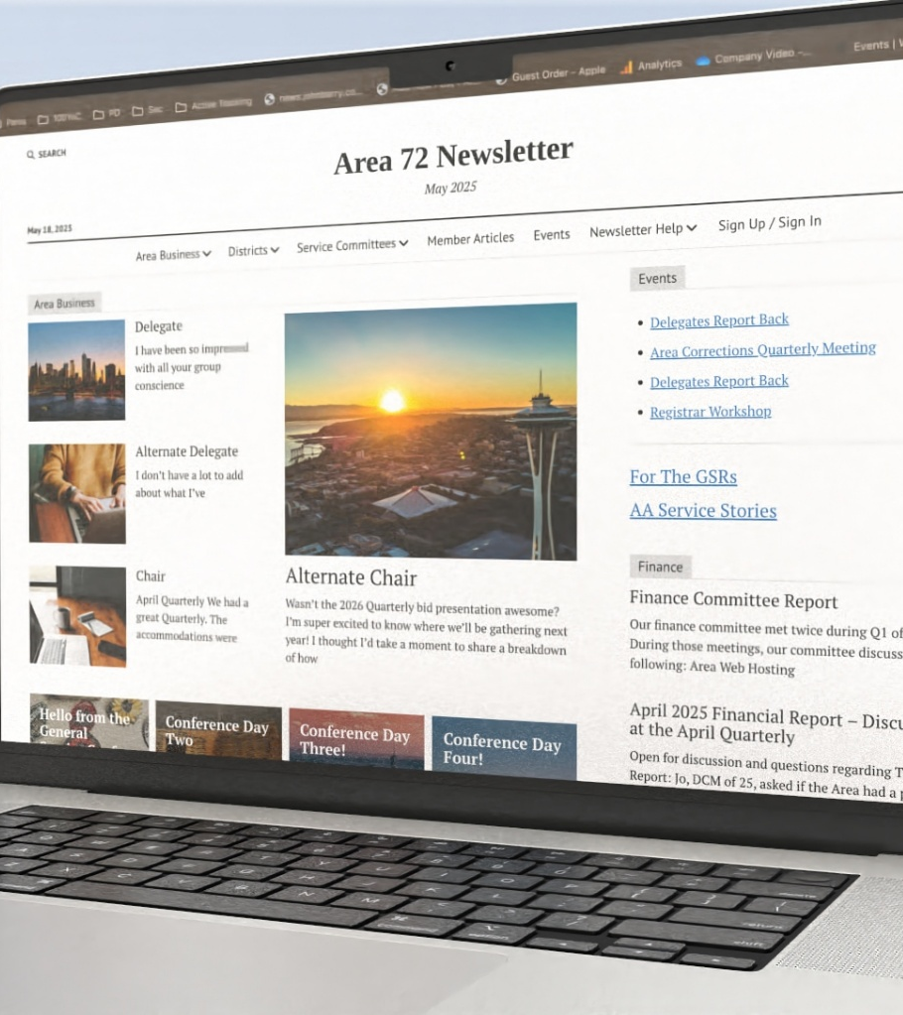
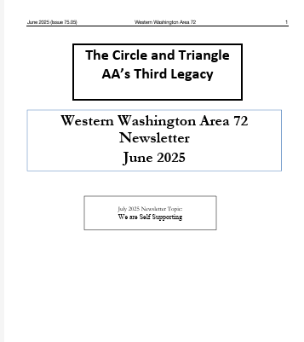
Newsletter
Ad Hoc Committee
Supplemental Report news@johnbarry.com
Notes:
This presentation was automatically generated by PowerPoint Copilot based on content found in this document:
https://creativeartsonline-my.sharepoint.com/personal/opsmgr_creative-arts_online/_layouts/15/Doc.aspx?sourcedoc=%7B779ECD8F-8661-40DC-BDBF-E6B157915874%7D&file=Overall%20Ad%20Hoc%20Committee%20Recommendations%20summary%2003032025%20final.docx&action=default&mobileredirect=true

Slide 2

Committee Members
Mike L.
Erin
Dave K.
Bud W.
Sooz B.
John B.
John K.
Debbie B.
Keith
Lupita YM
Theresa
Aarin
Jim
Geene D
Charley
Notes:
The Newsletter Ad Hoc Committee consists of various members including Mike L.
Erin
Jan
Dave K.
Bud W.
Sooz B.
John B.
John K.
Debbie B.
Mike M L.
Maryland N.
Lupita YM
Theresa
Aarin
Jim
Geene D
Original Content:
Geene D.
Newsletter Ad Hoc Committee Members:
Mike L., Erin, Jan, Dave K, and Bud W.
Sooz B., John B., John K., Debbie B., and Mike L.
Maryland N., Lupita YM., Theresa, Aarin, Jim

Slide 3
Agenda for Today
Accessibility – How can remote groups get the Area business info shared in the newsletter?
Printable Version of Newsletter – Can people easily print the digital version at home if they want a paper copy?
Archival Process – How do we make sure the newsletter format still works for keeping our Area’s history safe and organized?
Digital Newsletter and Cost – What does it really cost to print the newsletter, and how does that compare to going digital?
Recommendations from the Newsletter Ad Hoc Committee

Slide 4
General Purpose of the Newsletter
The Area 72 newsletter exists to keep groups and districts informed about the business activities of the Area.
Its primary role is to support the structure of the upside-down triangle, where trusted servants are guided by the fellowship.
The newsletter helps ensure that information flows from the Area to the groups through their GSRs and districts.
This allows members to stay informed and provide feedback, helping maintain a strong connection between the groups and Area service work.

Slide 5
Accessibility
The HTML-based newsletter solution improves accessibility.
The HTML format would make it easier for more people to stay informed and engaged with Area business.

Slide 6
Remote Communities
According to AA.org, remote groups are those that face challenges such as language, culture, geography, or limited internet. access. M-48i_0924.pdf
Language Barriers: Easily translated into Spanish by selecting the Spanish version
Rural Locations with Poor Internet: Lightweight HTML format loads quickly, even on slow or limited internet connections. Islands and parts of the Olympic Peninsula have limited band width. This is easier to load. Remote communities are used to accessing thru internet instead of paper.
Individuals in Custody: Stafford Creek Corrections Center and Clallam Bay Corrections Centers have reported that the printed version of the digital newsletter is acceptable to be brought into the facility ensuing those inside have access to Area business information if they wish. Some may be able to access the information online.
Visual Impairments: Digital format allows users to adjust text size, use screen readers, or apply high-contrast settings.
Young People and Young Heart: More tech-savvy and prefer digital formats. This solution meets them where they are—on phones, tablets, and other devices they already use.

Slide 7
What about those who can’t access digital?
Leverage Trusted Servants (DCMs and Area)
DCMs (District Committee Members):
Act as the primary point of contact for groups in their district.
Personally ensure that each group receives the newsletter, either digitally or in print.
Offer one-on-one support to technically challenged members to help them access the newsletter.
Area Trusted Servants
Training and Support:
Provide DCMs with simple guides or short training sessions on how to assist others.
Encourage DCMs to identify members in their groups who can act as “tech buddies” to help others.

Slide 8
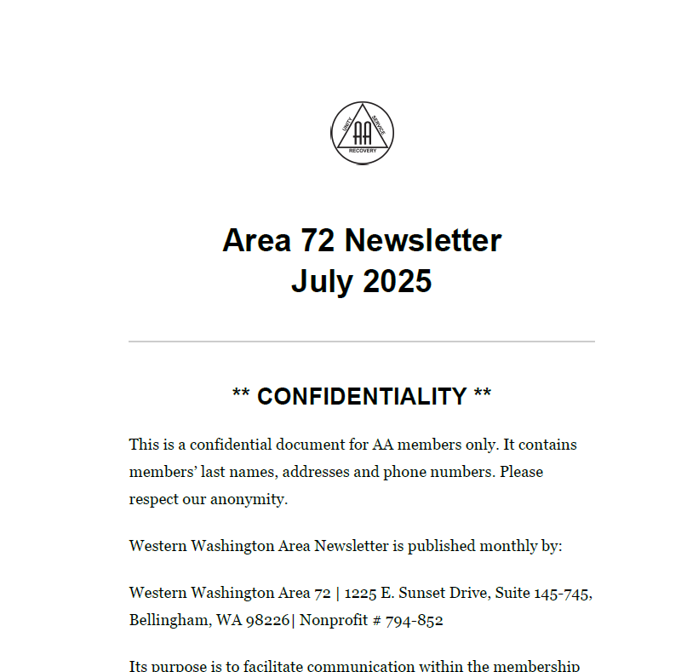
Printability
The digital newsletter can populate to a link of a simplified layout for printing on standard paper.
Live example: https://news.johnbarry.com/printable/2025/june/
Cost 28 pages = $4.00 free at some public libraries
*The current PDF is not printer-friendly: large file size, poor formatting for standard 8.5" x 11" paper, and requires more work to produce.

Slide 9
Archivable – Asked GSO
Website Content: GSO does not archive its website content directly. Instead, content is preserved by the departments that create it. The only exception was when the old website was retired—those pages were saved as PDF/A files.
Preservation Tools: GSO recommends using the Internet Archive’s Wayback Machine (https://web.archive.org) to view and preserve snapshots of public web content over time.
Searchability: For digitized documents, GSO uses OCR (Optical Character Recognition) to make text searchable. Handwritten documents may be retyped if needed.
Security & Privacy: Digital files should be protected using password protection, user permissions, and secure storage. Archives must also safeguard anonymity and sensitive information.
Digital Preservation vs. Digitization: Digitization is the process of converting physical materials into digital format. Digital preservation involves maintaining long-term access to those files, which includes regular backups, format updates, and secure storage.

Slide 10


Notes:
The fiscal analysis found potential cost savings by limiting print distribution and transitioning to digital formats. The report examined three perspectives: changing nothing, modifying distribution and page limits, and transitioning to digital formats.
Original Content:
Fiscal Analysis: Found potential cost savings by limiting print distribution and transitioning to digital formats. Their report examined from three perspectives change nothing, modify distribution and page limits, and digital formats.

Slide 11
Cost
Printed Newsletter – est. - $35,644.06
Printed Newsletter Cost Include:
The Ad hoc committee explored other options and formats of printing and found no other print options that would reduce costs.
Items that make up the full cost include:
Printing the newsletter
Postage
Additional cost not factored into the annual cost is Spanish Translation & Printing (4x/year):
Translation: ~$950 per issue
Printing: ~$900 per issue
Total: ~$7,400 annually

Slide 12
Newsletter Printing and Mailing
Expenses for 2025 – has a cap of spending of $20,000
Newsletter Printing & Mailing Expenses
 | 2021 | 2022 | 2023 | 2024 | Projected Estimated 2025 without CAP
TOTAL | $13,053.70 | $14,514.52 | $22,946.87 | $29,709.22 | $35,644.06
Percent of Annual Expenses | 9% | 10% | 12% | 17% | 20%

Slide 13
Digital Newsletter Cost
Total annual cost: $1,495.00
Total startup cost: $1,094.00
First-year total (startup + annual): $2,589.00
Ongoing- $1,495.00
Description | Cost per Year | Initial Costs | Notes
Content Views Pro plugin | $20 | $39 | Controls how articles show on the home page and archives
MailPoet email system | $120 | $0 | Sends the newsletter and subscriber updates directly from the site
Mission News Pro theme | $25 | $49 | WordPress theme that controls the site’s layout
Wordfence security plugin | $150 | $150 | Protects the site and keeps WordPress security up to date
WP Mail SMTP plugin | $50 | $50 | Ensures site emails (like subscriptions and contact forms) are delivered reliably
WPForms Pro plugin | $200 | $200 | Used to build and manage forms—story submissions, surveys, etc. Recommended version allows uploads to Google Drive and supports polls
WPML Multilingual CMS | $106 | $106 | Adds support for Spanish and other languages across posts, pages, menus, and categories
WPML translation credits | $324 | $0 | Needed for machine translation of content (300k credits/year)
Single Sign-on system | $500 | $500 | Allows users to maintain one profile across area72aa.org and the new newsletter site. Final approach to be selected by the transition team

Slide 14
Annual Cost Comparison: Printed vs. Digital Newsletter
Changing to a digital newsletter could save the Area 72 over $34,000 annually.

Slide 15

Where Spirituality and Money Mix.
Financial decisions are guided by our spiritual principles—not just cost.
Our primary purpose remains: to carry the message to the alcoholic who still suffers.
The digital newsletter supports this mission by:
  Reaching more members, including remote and underserved communities.
  Providing timely, flexible access to important updates.
  Reducing costs by over $30,000 per year compared to print.
Redirects savings to support outreach and other 12 step efforts.
It’s not just about saving money.

Slide 16
The Newsletter Ad Hoc Committee’s Recommendation
Transition to a digital newsletter format using the HTML-based solution such as the one demonstrated at the July Quarterly.
Cease regular monthly printing of the newsletter, while allowing for limited printing as needed.

Slide 17
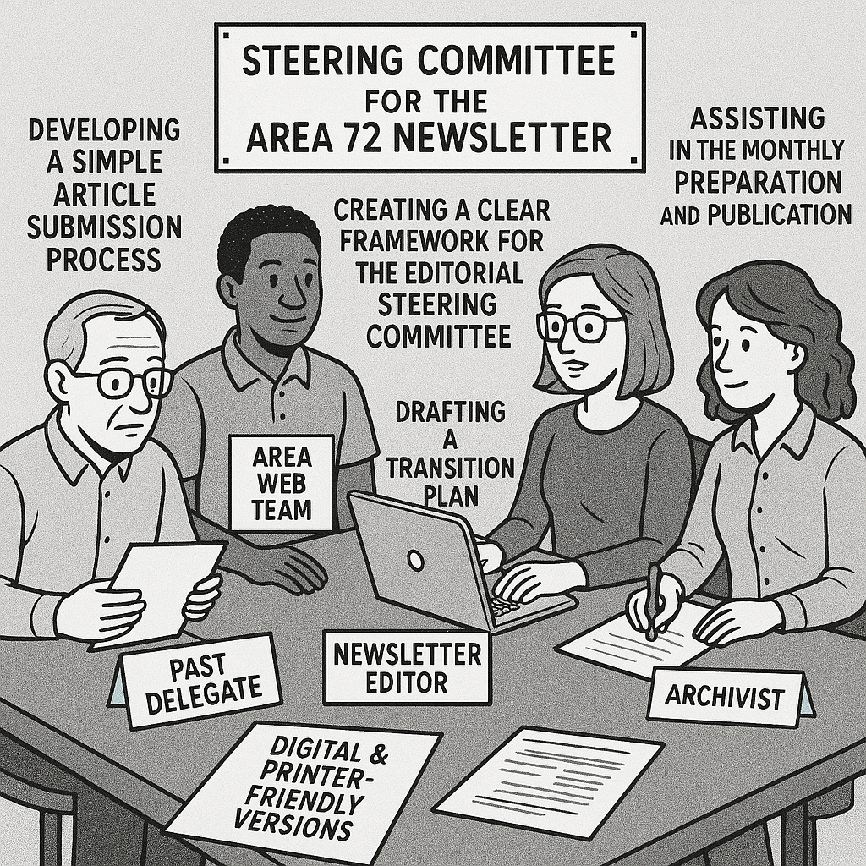
Recommendations Continued:
Steering Committee Chaired by the Newsletter Editor
Create a steering committee chaired by the newsletter editor that at a minimum contain the following: Newsletter editor, web servant, archivist, past delegate, DCMs, general AA members.
  Role of the steering committee:
  Maintain the monthly digital newsletter.
  Consider expanding the scope of the newsletter to include other articles on monthly topics, a birthday corner, and interviews from various AA members.
  Develop guidelines to ensure that the digital newsletter maintain adherence to our steps, traditions, and concepts.

Slide 18
Recommendations Continued
Implement a subscription option on the Area website to automatically notify members with a link of the monthly digital newsletter.
Support districts and GSRs in printing copies for members who need them.
Establish a digital archival process in line with GSO guidelines.
Redirect savings to support outreach and other 12th Step efforts.

Slide 19

Presentation of the Digital Newsletter news@johnbarry.com

Slide 20

The ad hoc committee thanks you all for letting us be of service.

