Slide 1


The Group Conscience in Preparation for the 2021 71st General Service Conference
Geene D, Western Washington Area 72
Panel 71 Delegate
delegate@area72aa.org
Cell: 360-463-6762
www.area72aa.org
Notes:
Thank you in advance for helping me prepare for the 71st General Service Conference (GSC). There are multiple ways you can help me prepare. First and foremost, please come to a Pre-Conference. There are four different Pre-Conferences and you can come to which ever works best for you.
The purpose of the Pre-Conferences is for the Delegate to communicate with the GSRs (and through them, to the Group) about some issues which will be addressed at the General Service Conference (held in April). This way the GSRs can inform the Delegate about their Groups conscience on the issues so that the Delegate has a sense of our Area while attending the General Service Conference.

Slide 2
Area 72
2,003 Groups
42 Districts (2 Linguistic)
Area 72
1 Delegate

Slide 3
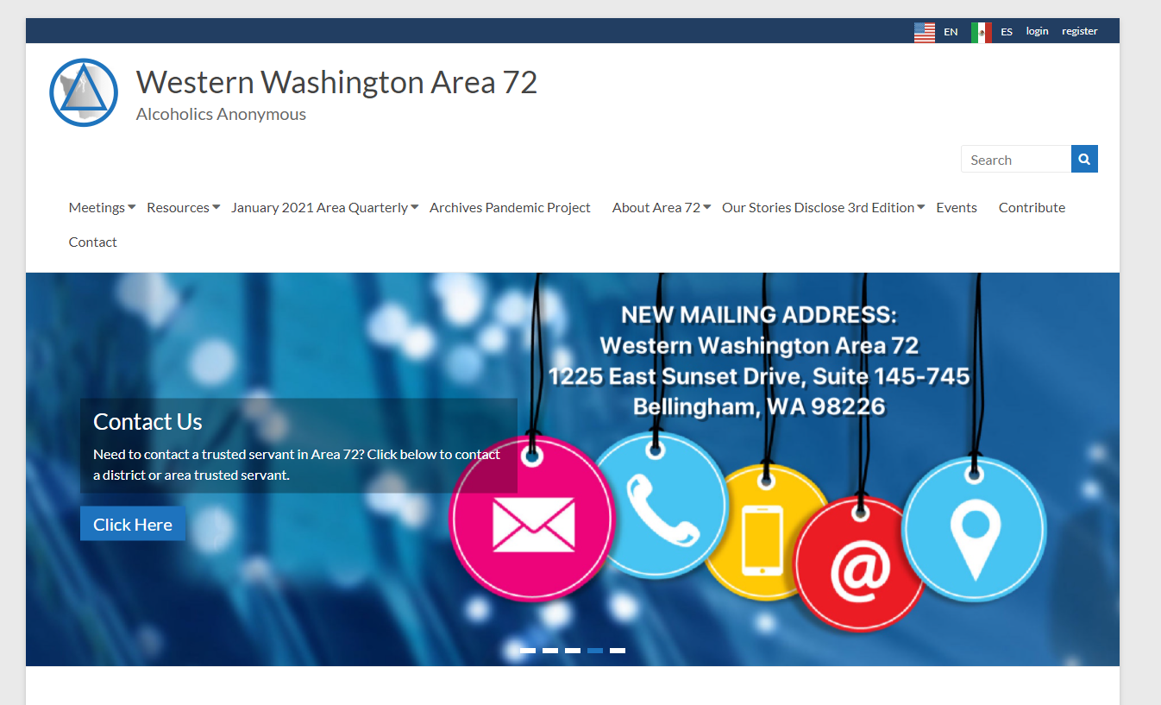
Communication by Website
msca09aa.org

Slide 4
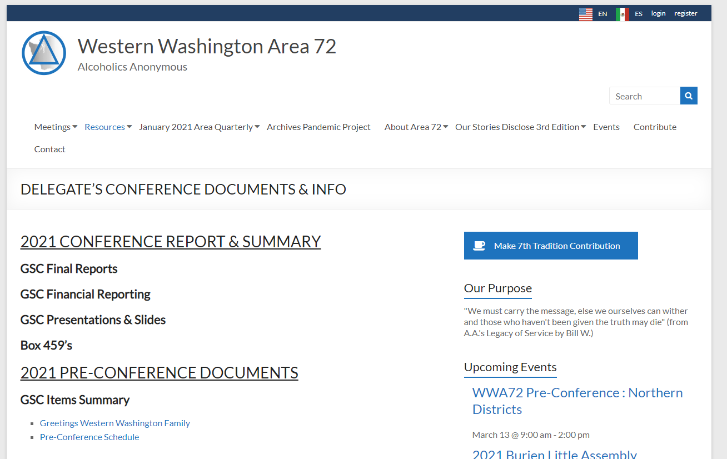
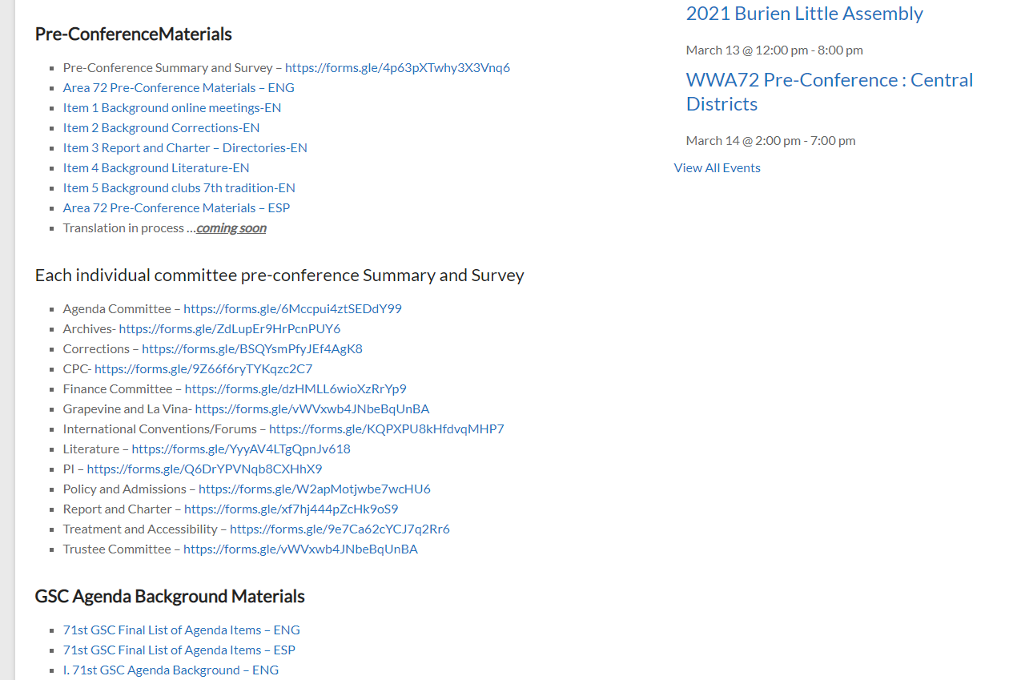
Communication by Website

Slide 5
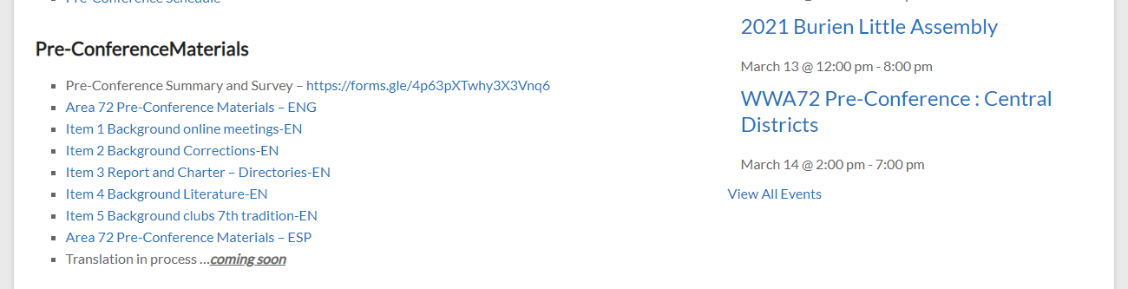
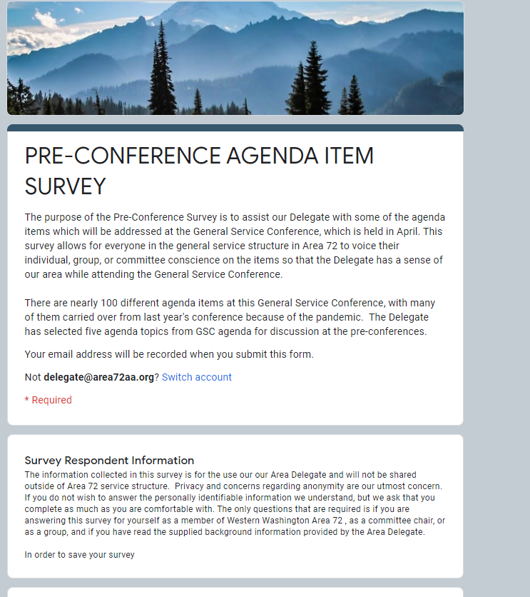
Communication by Website

Slide 6
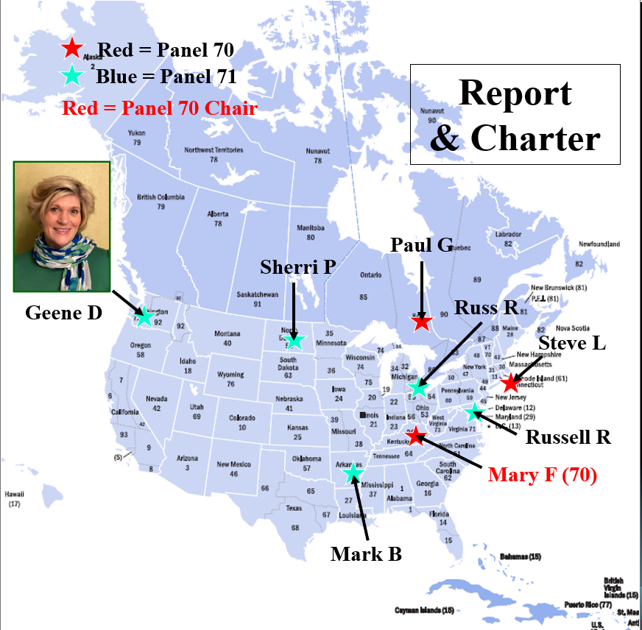
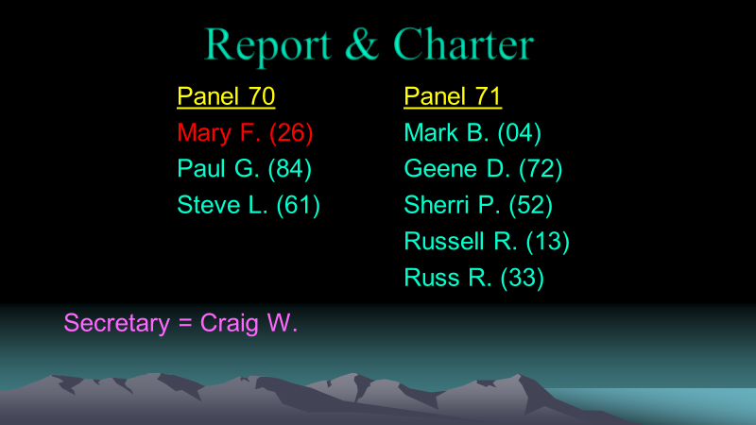
13 Conference Committee Assignments in late December

Slide 7
Items for considerations
Full agenda has over 100 items
The full agenda and background can be found online on our website
If you wish to make comment on all agenda items there are surveys for each committee for you to provide you or your groups feedback.
Just so you know, at the GSC all topics will be discussed by each committee but that doesn’t mean the committee will recommend sending the topic to the whole Conference for consideration and vote.
www.area72aa.org
Notes:
The full conference agenda is available with background.
Due to the pandemic many topics from the 70th General Service Conference were moved to this year. As a result, there are over 100 agenda items.
Just so you know, at the GSC all topics will be discussed by each committee but that doesn’t mean the committee will recommend sending the topic to the whole Conference for consideration and vote.
I have posted the entire agenda by sections (Committees) on the Area web page for your reading pleasure. If you would like to review certain sections and provide feedback or even feedback on the entire conference it is available on the area web page.

Slide 8
Items for considerations
For the Pre-Conference
Items for consideration:
Policy/Admissions – Consider request regarding participation of online groups in the General Service Structure
Corrections - Discuss innovative ways of carrying the message to alcoholics in correctional facilities/programs.
Report and Charter – Discuss the AA Directories (Canada, Eastern U.S., and Western U.S.)
Literature - This discussion is meant to sparks a conversation – Is there a problem with our literature that prevents someone from identifying with our common message? IF so, why?
Finance - Reconsider the 1972 G.S.C. Advisory Action stating “G.S.O. should not accept contributions from clubs, listed or known as such, whether or not composed solely of A.A. members. Contributions are welcome from groups meeting in clubs as long as they are sent in the name of the group.”
Please pay special attention in these summaries to the section that ask the questions. This is what your Delegate needs to learn from you.
Remember when talking about this– think broadly about this. What is best for AA as a whole?
www.area72aa.org
Notes:
The full conference agenda is available with background.
Due to the pandemic many topics from the 70th General Service Conference were moved to this year. As a result, there are over 100 agenda items.
Just so you know, at the GSC all topics will be discussed by each committee but that doesn’t mean the committee will recommend sending the topic to the whole Conference for consideration and vote.
I have posted the entire agenda by sections (Committees) on the Area web page for your reading pleasure. If you would like to review certain sections and provide feedback or even feedback on the entire conference it is available on the area web page.

Slide 9
Item 1 - Policy/Admissions
Consider request regarding participation of online groups in the General Service Structure
How does your group feel about online only groups wanting to participate within the General Service Structure?
Do you or your group think online only groups not participating in the service structure is a problem that should be address by GSO? Please explain why or why not?
Who are we missing from General Service without allowing online only meetings to be recognized?

Slide 10
Item 2 - Corrections
Discuss innovative ways of carrying the message to alcoholics in correctional facilities/programs.
Questions for discussion:
What are new innovative ways to carry the message to alcoholics in correctional facilities/programs?
What do you or your group think about the included shared ideas?
What new ideas or suggestions could you or group could share?

Slide 11
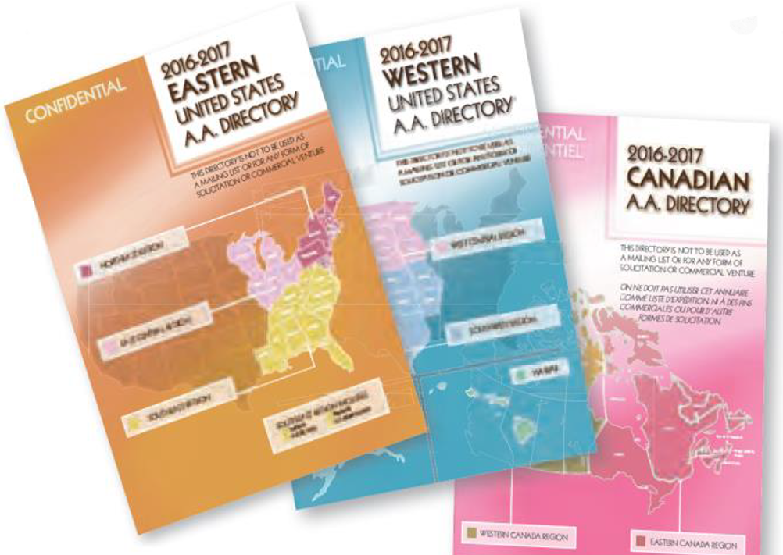
Item 3 - Report and Charter
Discuss the AA Directories (Canada, Eastern U.S., and Western U.S.)
Questions for discussion:
Are you or your group familiar with the AA Directories (Canada, Eastern U.S., and Western U.S.)?
What could be an alternative method of accessing and distributing the contact information contained in the A.A. Directories?

Slide 12
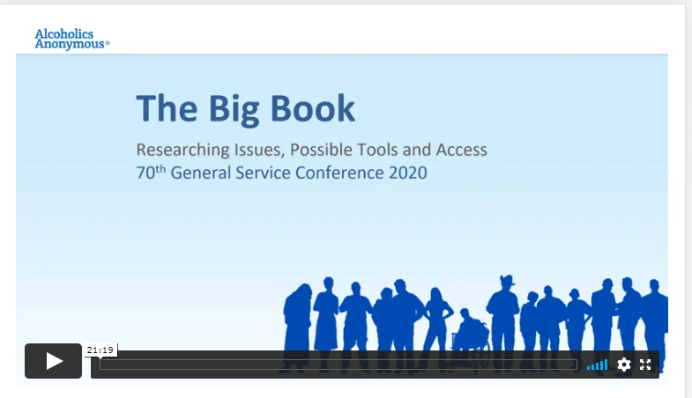
Item 4 - Literature
This discussion is meant to sparks a conversation – Is there a problem with our literature that prevents someone from identifying with our common message? IF so, why?
Questions for discussion:
Should the Literature Committee explore possible solutions that could help make our message more available? IF so, what additional information would be helpful to determine if additional items are needed to increase accessibility and relatability to the AA program?
Is there a problem with our literature that prevents someone from identifying with our common message? If so, why?
What has been done to address accessibility/relatability challenges in our literature?
Our program of recovery depends upon on the alcoholic to be able to self-identify. What could be done about relatability? How is our big book meeting the need of self-identification?
Do we need to grow and change with time?
Would a translation into modern or simple langue help? What tools would help others understand our program of recover? Workbooks? Dictionaries?
https://vimeopro.com/user112910871/big-book-riptab/video/500617913

Slide 13
Item 5 - Finance
Reconsider the 1972 G.S.C. Advisory Action stating “G.S.O. should not accept contributions from clubs, listed or known as such, whether or not composed solely of A.A. members. Contributions are welcome from groups meeting in clubs as long as they are sent in the name of the group.”
Questions for discussion:
Should districts, areas or GSO be able to accept contributions from a Club? Why or why not?

Slide 14
Thank you for being part of the Conference Process!
Geene D, Western Washington Area 72
Panel 71 Delegate
delegate@area72aa.org
Cell: 360-463-6762
Please complete the surveys found online.

